Slide 1
Replication
Lecturer: Ngo Huy Bien
Software Engineering Department
Faculty of Information Technology
VNUHCM - University of Science
Ho Chi Minh City, Vietnam
nhbien@fit.hcmus.edu.vn

Slide 2

Objectives
To implement replication using primary-backup approach and bully algorithm (or ring algorithm).

Slide 3

Contents
Replication Terminologies.
Primary Backup Replication.
Bully Algorithm.
Ring Algorithm.

Slide 4

References
Navin Budhiraja et al. (1993). The Primary Backup Approach.
Maarten van Steen and Andrew S. Tanenbaum (2023). Distributed Systems. CreateSpace Independent Publishing Platform.

Slide 5
Why Replication?
To provide availability.
What is availability? - App can make progress despite failures.
Which failures can replication deal with? - It depends on selected protocol.
To reduce latency.
To increase read throughput.

Slide 6
Kind of Failures that Replication Can Tolerate
"Fail-stop" failure of a single replica.
Fan stops working, CPU overheats and shuts itself down.
Someone trips over replica's power cord or network cable.
Software notices it is out of disk space and stops.
Earthquake or city-wide power failure.
Replicas must be physically separated.

Slide 7
Kind of Failures that Replication Cannot Tolerate
Defects in hardware.
Disk block errors.
Sometimes can be detected (e.g. checksums).
Bugs in software.
Human configuration errors.
Network errors.
Network partition, messages are lost, duplicated, or reordered.

Slide 8
Replication of What
State transfer (State replication).
Replicated state machine (State machine replication).

Slide 9
State Transfer
A replica receives a request (operation).
The replica executes the operation (i.e. does calculation to create a result).
The replica sends the result (calculated data) to other replicas.
State transfer is simpler.
But state may be large, slow to transfer over network.

Slide 10
State Transfer Example
User's age: 20.
Only Replica 1 executes: UpdateAge(User, 30).
Replica 1 ships its WAL record to Replica 2.
The log record already contains the value (30).
Also known as passive replication: State calculation is done on only one replica.

Slide 11
Replicated State Machine
Clients send requests (operations) to a replica.
The replica sequences and sends the operations to other replicas.
All replicas execute all operations.
If same start state,
same operations,
same order,
deterministic,
then same end state.
Replicated state machine often generates less network traffic.
Operations are often small compared to state.
But complex to get right. Example: The update operation must be deterministic (i.e. no random function call).

Slide 12
Replicated State Machine Example
User's age: 20.
Replica 1 executes: UpdateAge(User, 30).
Replica 1 ships its WAL record to Replica 2. The log contains the command.
Replica 2 executes: UpdateAge(User, 30).
Also known as active replication: State calculation is done on all replicas.
Also known as state machine replication.

Slide 13
Replication Level
At what level do we want replicas to be identical?
Application level, e.g. a database's table?
Can be efficient; a replica only sends data or operations to others.
Application code (server) must understand fault tolerance, to e.g. forward data or operation stream.
Machine level, e.g. registers and RAM content?
Might allow us to replicate any existing server without modification.
Requires forwarding of machine events (interrupts, direct memory access (DMA))
Requires OS or hardware modifications to send or receive event stream.

Slide 14


Slide 15
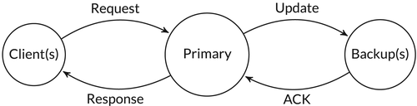
Primary-Backup Replication [1]
To designate one server as the primary and all the others as backups.
Clients make requests by sending messages only to the primary.
If the primary fails then a failover occurs and one of the backups takes over.

Slide 16
Examples
MySQL (with Master-Slave Replication)
PostgreSQL (Streaming Replication)
Microsoft SQL Server (Always On Availability Groups)
MongoDB
Hadoop Distributed File System (HDFS)
VMware vSphere
Etcd
Amazon DynamoDB

Slide 17
Properties (I)
We require that to be a primary-backup protocol, four properties must be satisfied.
Pb1: There exists a local predicate Prmy_{s} on the state of each server s. At any time there is at most one server s whose state satisfies Prmy_{s}. No more than one server can be the primary at any time.
We can now formally define the failover time of a primary-backup service to be the longest period of time during which Prmy_{s} is not true for any s.

Slide 18
Properties (II)
Pb2: Each client i maintains a server identity Dest_{i} such that to make a request client i sends a message to Dest_{i}.
Property Pb2 distinguishes the primary-backup approach from the state machine approach (?). In the latter, each client broadcasts its request to all the servers (at considerable cost).
(?) State machine replication can be implemented using the primary-backup approach if a leader and quorum are selected.

Slide 19
Properties (III)
Pb3: If a client request arrives at a server that is not the current primary then that request is not enqueued (and therefore is not processed).
We assume that requests sent to a server s are enqueued in a message queue at s. Requests that arrive at a backup are ignored.
Pb1, Pb2, and Pb3 ensure that no more than one server can enqueue each client request. Eliminating Pb2 would allow protocols in which this could be violated. In such a protocol, a client would send its request to multiple servers. And if this request were sent while the identity of the primary is changing then the request could get enqueued at more than one server.

Slide 20
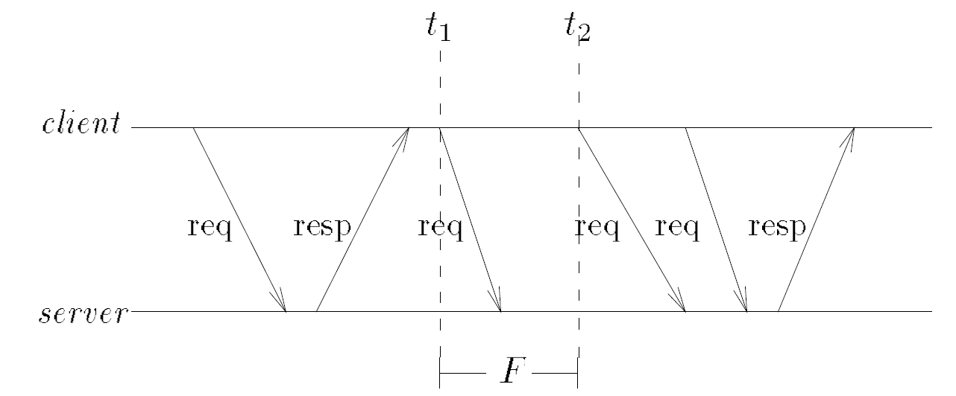
Properties (IV)
Define a server outage to occur at time t in this service if some correct client sends a request at time t to the service but does not receive a response.
The above server is called a (k, △)-bofo server (bounded outages, finitely often) if all server outages can be grouped into at most k intervals of time, with each interval having length at most △.
For example the computation shown in Figure below shows two server outages at times t₁ and t₂ respectively.
If the length of this outage period is F and if this is the only such period, then the server is (k, △)-bofo. Thus, even though some requests made to a (k, △)-bofo server can be lost, the number of such requests is bounded.

Slide 21
Properties (V)
Pb4: There exist fixed values k and △ such that the service behaves like a single (k, △)-bofo server.
Pb4 implies that primary-backup protocols can be used only to implement services that tolerate a bounded number of failures over their lifetime.
In practice, we can implement a service that tolerates an unbounded number of failures by partitioning its operation into periods. Only a bounded number of failures occur in each period, and repaired servers are reintegrated at period boundaries. Pb4 need only hold throughout each period. We do not discuss reintegration.

Slide 23
A Simple Primary-Backup Protocol (I)
An example of a primary-backup protocol that tolerates the crash of a single server.
An example of asynchronous replication.
Important note: Define system model first before solving the distributed problem.
Assume that all communication is over point-to-point non-faulty links and that each link has an upper bound δ on message delivery time.
There exists a primary server p₁ and a backup server p₂ connected by a communications link.

Slide 24
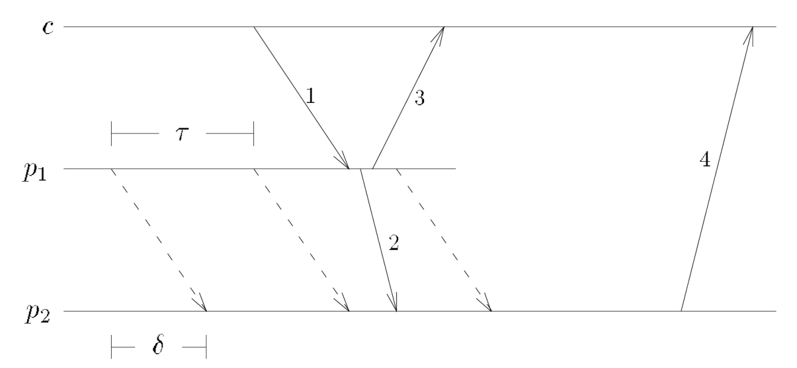
A Simple Primary-Backup Protocol (II)
A client c initially sends a request to p₁ (indicated by the arrow labeled 1 in the figure).

Slide 25
A Simple Primary-Backup Protocol (III)
Whenever p₁ receives a request, it
Processes the request and updates its state accordingly.
Sends information about the update to p₂ (message 2 in the figure). We call such a message a state update message.
Without waiting for an acknowledgement from p₂ sends a response to the client (message 3 in the figure).

Slide 26
A Simple Primary-Backup Protocol (IV)
The order in which messages 2 and 3 are sent is important because it guarantees that, given our assumption about failures (i.e. the system model), if the client receives a response, then either p₂ will eventually receive the state update message or p₂ will crash.
The system model: fail-stop and reliable links model.

Slide 27
A Simple Primary-Backup Protocol (V)
In addition, p₁ sends dummy messages to p₂ every τ seconds (shown by the dashed arrows in the figure).
If p₂ does not receive such a message for τ + δ seconds, then p₂ becomes the primary.
Once p₂ has become the primary, it informs the clients (message 4 in the figure) and begins processing subsequent requests from the clients.

Slide 28
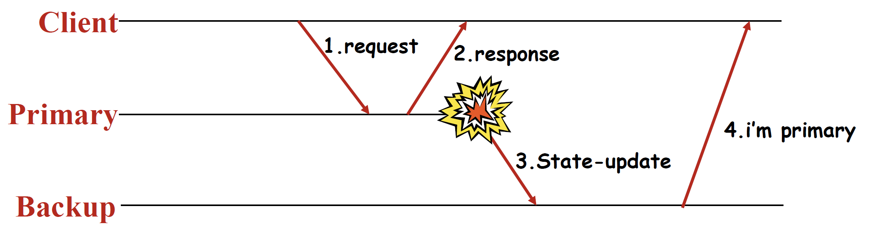
Question 1: Data Loss?
Client submits a request to the primary, who replicates it to the backup after responding to the client.
The primary and backup execute exactly the same sequence of requests in the same order.
What happens if the primary crashes right after sending a response to the client? The backup is one request behind the primary.

Slide 30
The Alsberg and Day Protocol (I)
An example of synchronous replication.
A client sends a request to the service and then blocks waiting for either a response from the service or a timeout.
If the request arrives at the primary, then the primary performs the requested update, sends a state update message to the backup, and blocks.
The backup, upon receiving the state update message, updates its state, sends the response to the client (- how? The backup should send the response to the primary, not to the client!), and finally sends an acknowledgement to the primary saying that it performed the update.
On receiving the acknowledgement, a primary can unblock and process the next pending request.

Slide 31
The Alsberg and Day Protocol (II)
Failures are detected by lost acknowledgement messages.
In addition, failures are also detected by sending periodic "Are you alive" messages.
In case the primary fails, the backup takes over as the new primary.
And, when a primary has no backup (either because the backup crashed or the backup becomes the primary), the primary uses another protocol to recruit another server to become the backup.

Slide 32
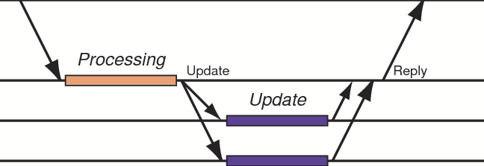
Question 2: Data Consistency?
Client submits a request to the primary, who replicates it to the backup before responding to the client.
The primary and backup must execute exactly the same sequence of requests in the same order.
What happens if the primary crashes right before sending a response to the client? The backup is one request ahead of the primary.

Slide 33
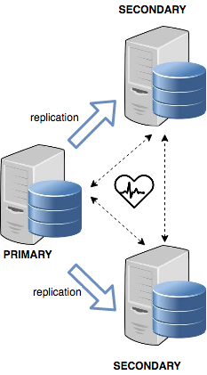
Question 3: Detect the Primary Status?
How can the primary's status be detected?
Through ping timeouts.
Should the primary ping the backups, or should the backups ping the primary?
How to implement a simple failure detector technically?

Slide 34
Question 4: Elect a New Primary?
How to elect a new primary server?

Slide 36
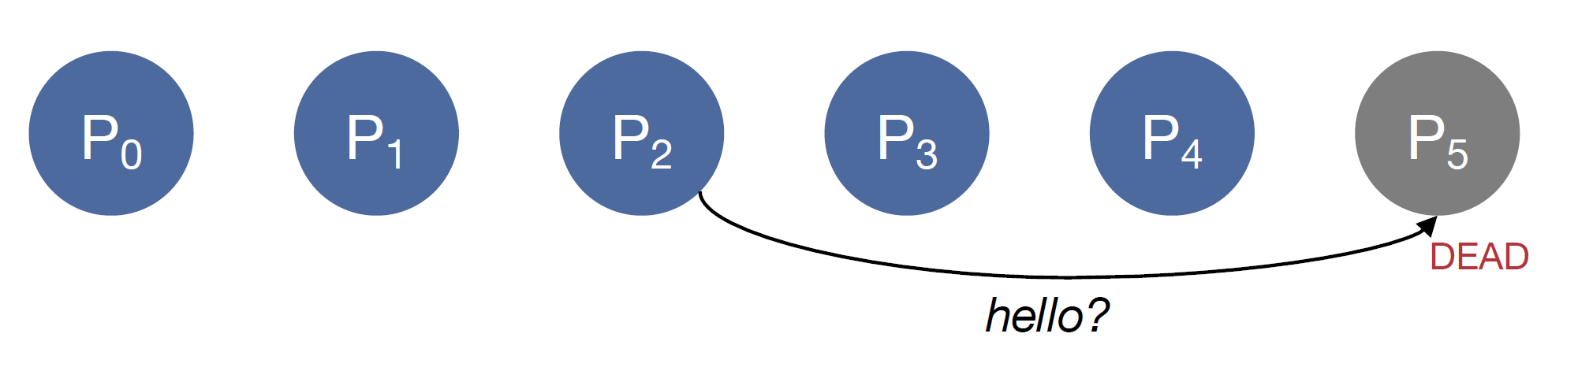
Bully Algorithm Example (I)
Suppose P₅ dies.
P₂ detects P₅ is not responding.

Slide 37
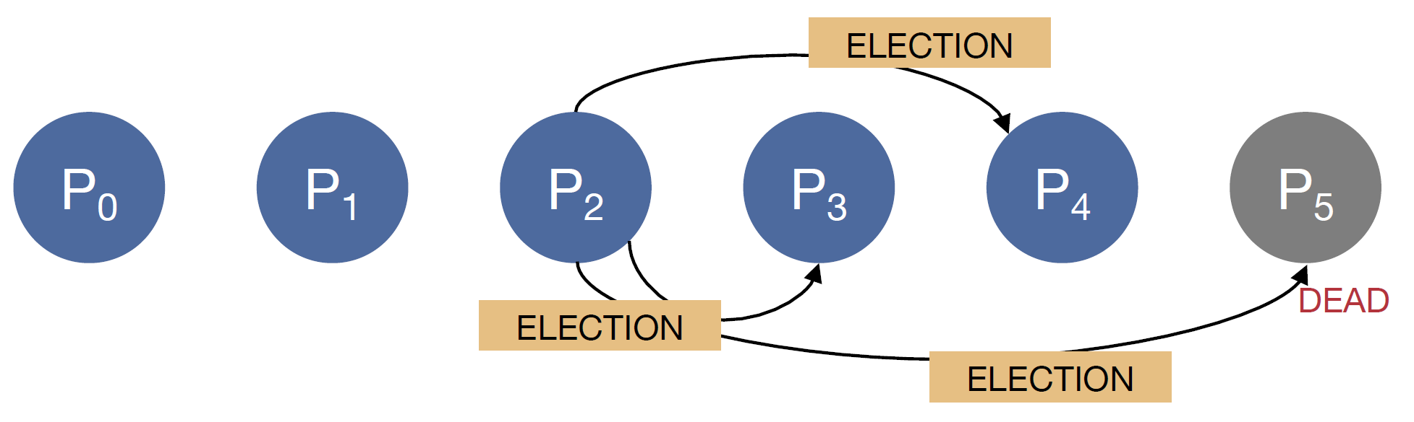
Bully Algorithm Example (II)
P₂ starts an election.
Contacts all higher-numbered systems.

Slide 38
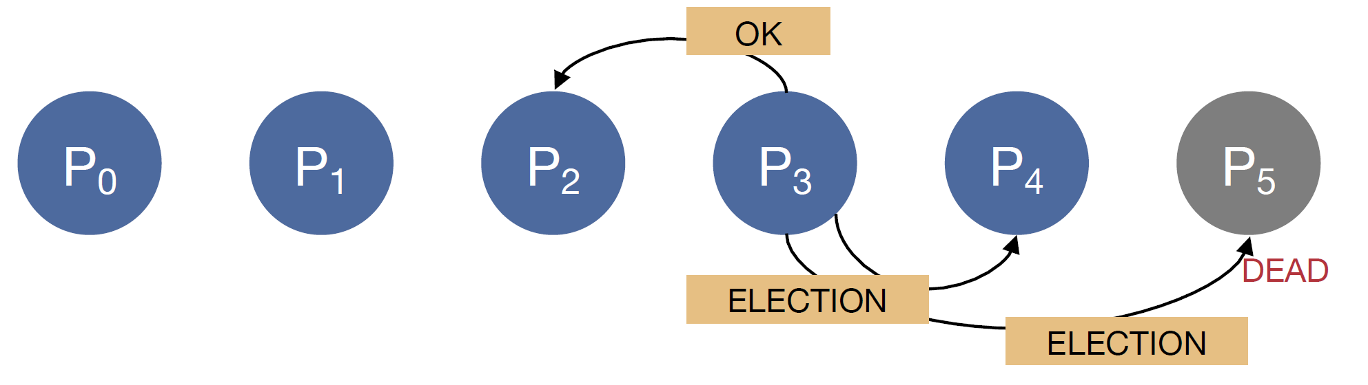
Bully Algorithm Example (III)
P₃ receives the message from P₂.
Responds to P₂.
Sends ELECTION messages to P₄ and P₅.

Slide 39
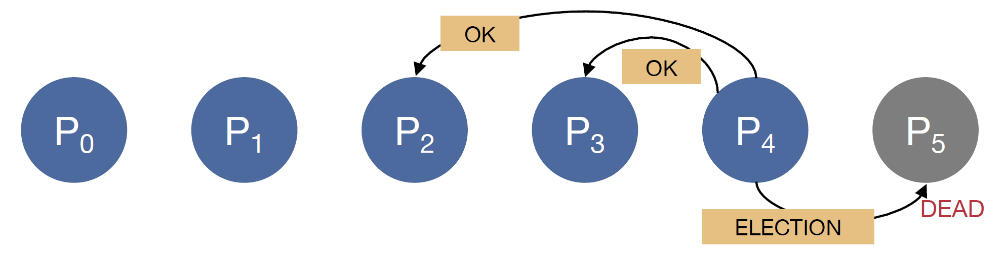
Bully Algorithm Example (IV)
P₄ receives the message from P₃ and P₂.
P4 responds to P3 and P2's messages.
… and holds an election

Slide 40
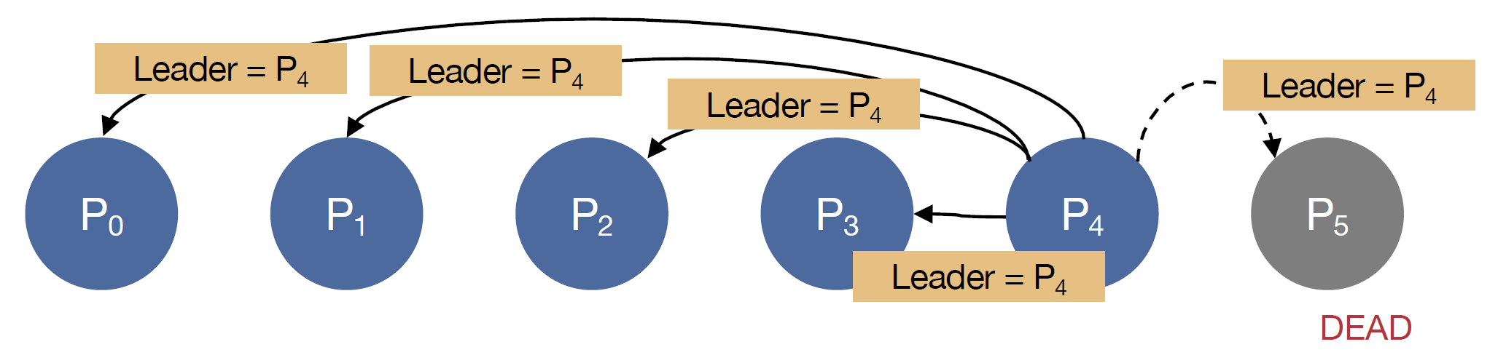
Bully Algorithm Example (IV)
Nobody responds to P₄.
After a timeout, P₄ declares itself the leader.

Slide 41
Bully Algorithm Implementation
https://github.com/Abdulsametileri/leader-election-bully-algorithm

Slide 42
Bully Algorithm (I) [2]
Consider N processes {P₀, . . . , P_{N−1}} and let id(P_{k}) = k. When any process notices that the coordinator is no longer responding to requests, it initiates an election.
A process, Pk, holds an election as follows:
Pk sends an ELECTION message to all processes with higher identifiers: P_{k+1}, P_{k+2}, . . . , P_{N−1}.
If no one responds, P_{k} wins the election and becomes coordinator.
If one of the higher-ups answers, it takes over and P_{k}'s job is done.
At any moment, a process can get an ELECTION message from one of its lower-numbered colleagues. When such a message arrives, the receiver sends an OK message back to the sender to indicate that it is alive and will take over. The receiver then holds an election, unless it is already holding one.

Slide 43
Bully Algorithm (II)
Eventually, all processes give up but one, and that one is the new coordinator.
It announces its victory by sending all processes a COORDINATOR message telling them that starting immediately it is the new coordinator.
If a process that was previously down comes back up, it holds an election. If it happens to be the highest-numbered process currently running, it will win the election and take over the coordinator's job. Thus the biggest guy in town always wins, hence the name "bully algorithm."

Slide 44
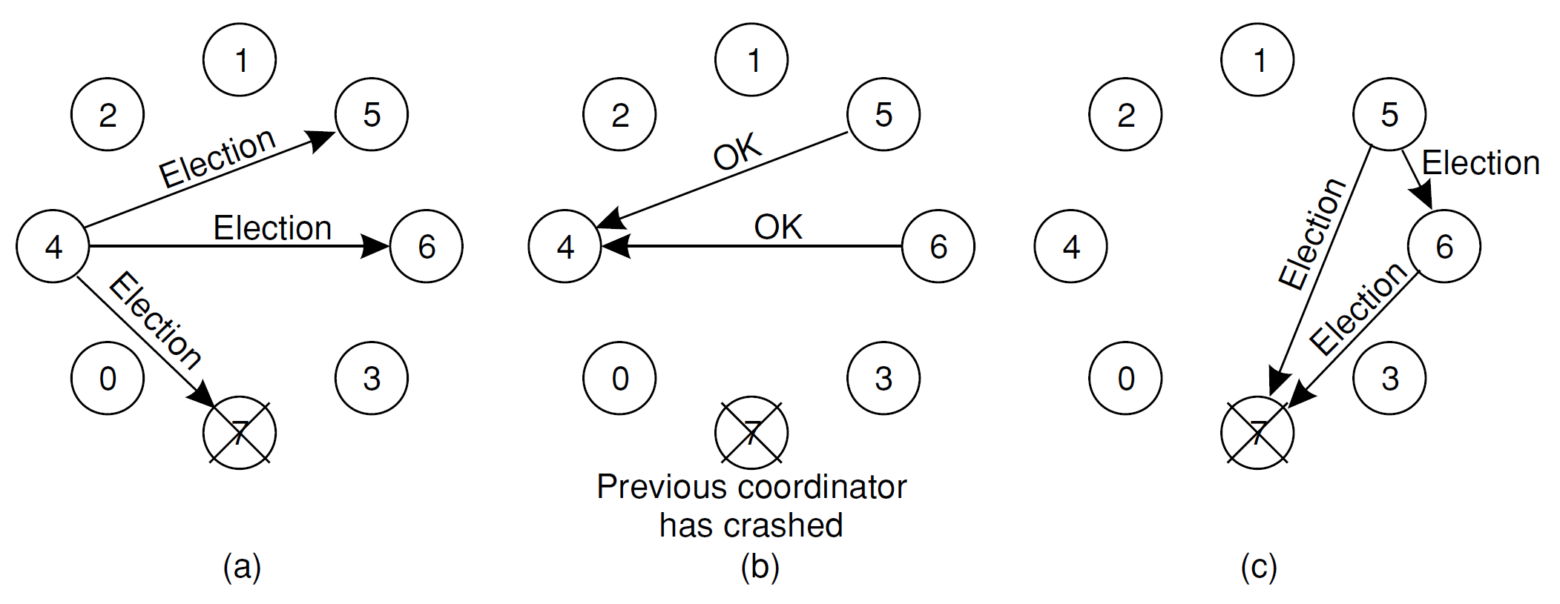
Bully Algorithm Example 2 (I)
(a) Process 4 holds an election.
(b) Processes 5 and 6 respond, telling 4 to stop.
(c) Now 5 and 6 each hold an election.

Slide 45
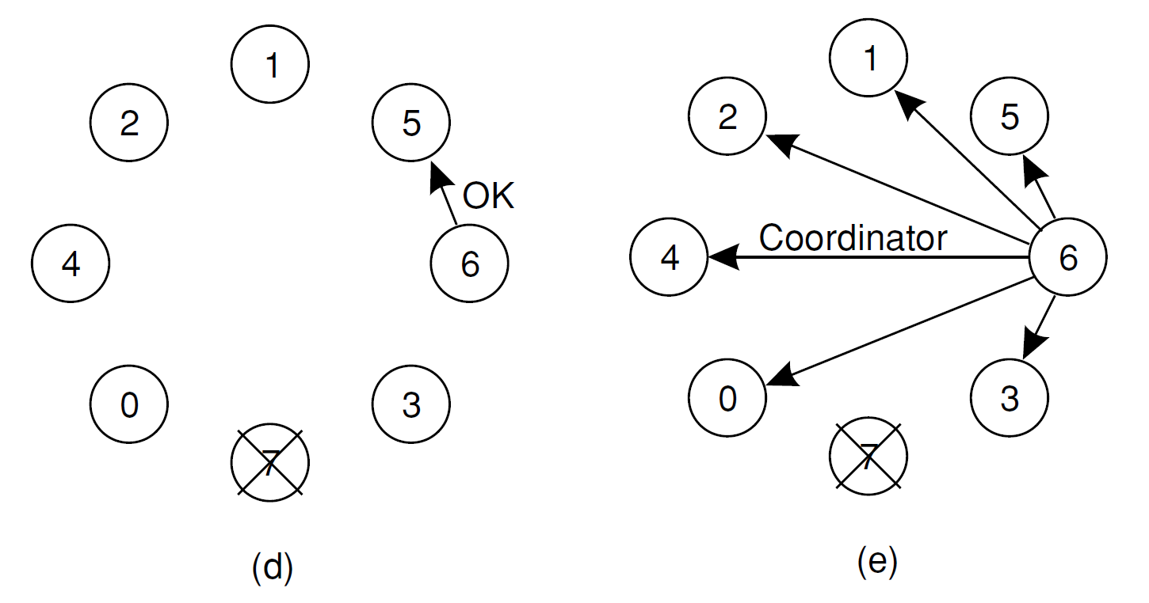
Bully Algorithm Example 2 (II)
(d) Process 6 tells 5 to stop.
(e) Process 6 wins and tells everyone.

Slide 47
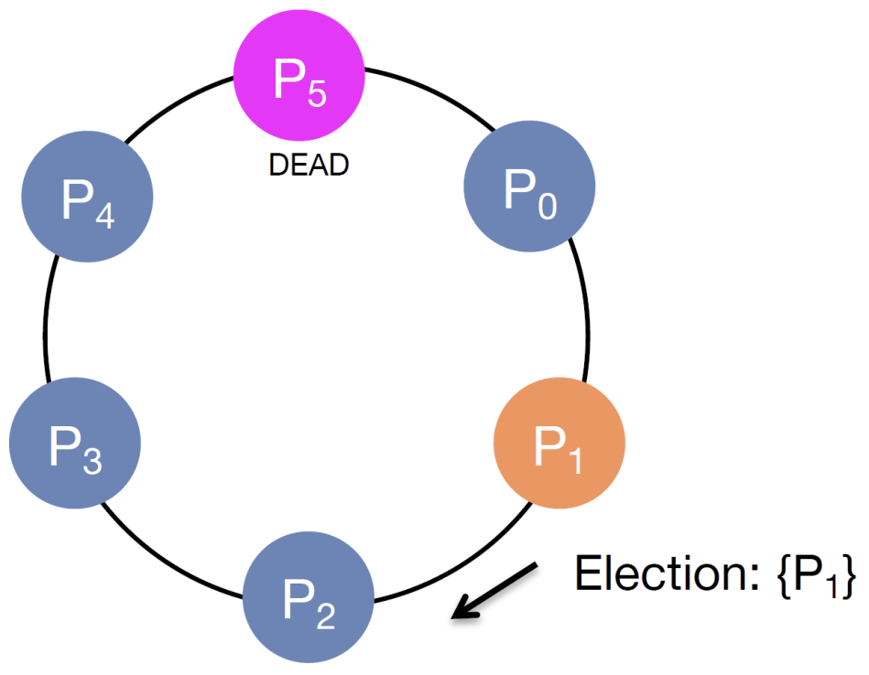
Ring Algorithm Example (I)
Assume P1 discovers that the leader, P5, is dead.
P1 starts an election.

Slide 48
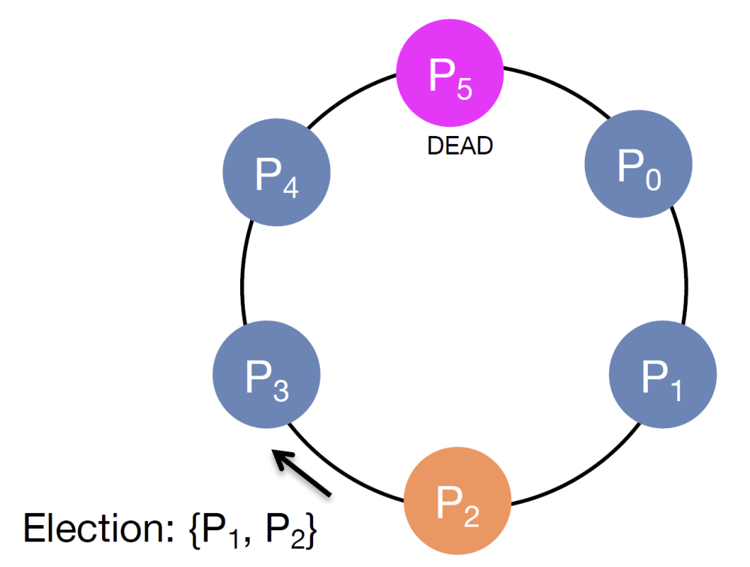
Ring Algorithm Example (II)

Slide 49
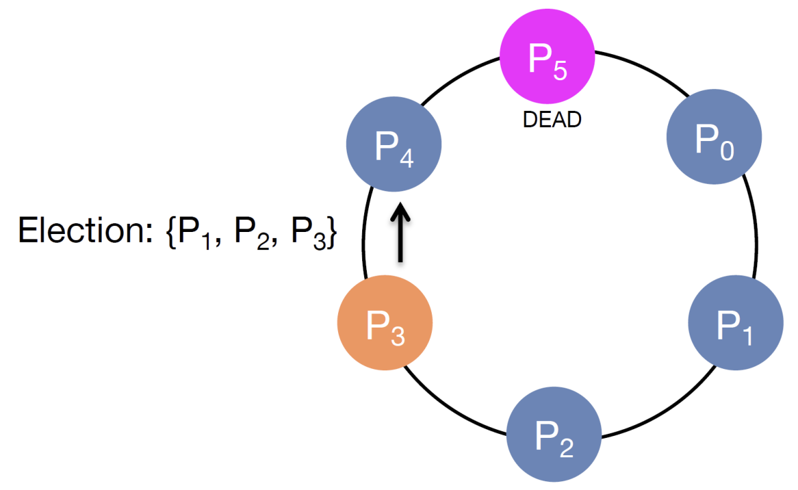
Ring Algorithm Example (III)

Slide 50
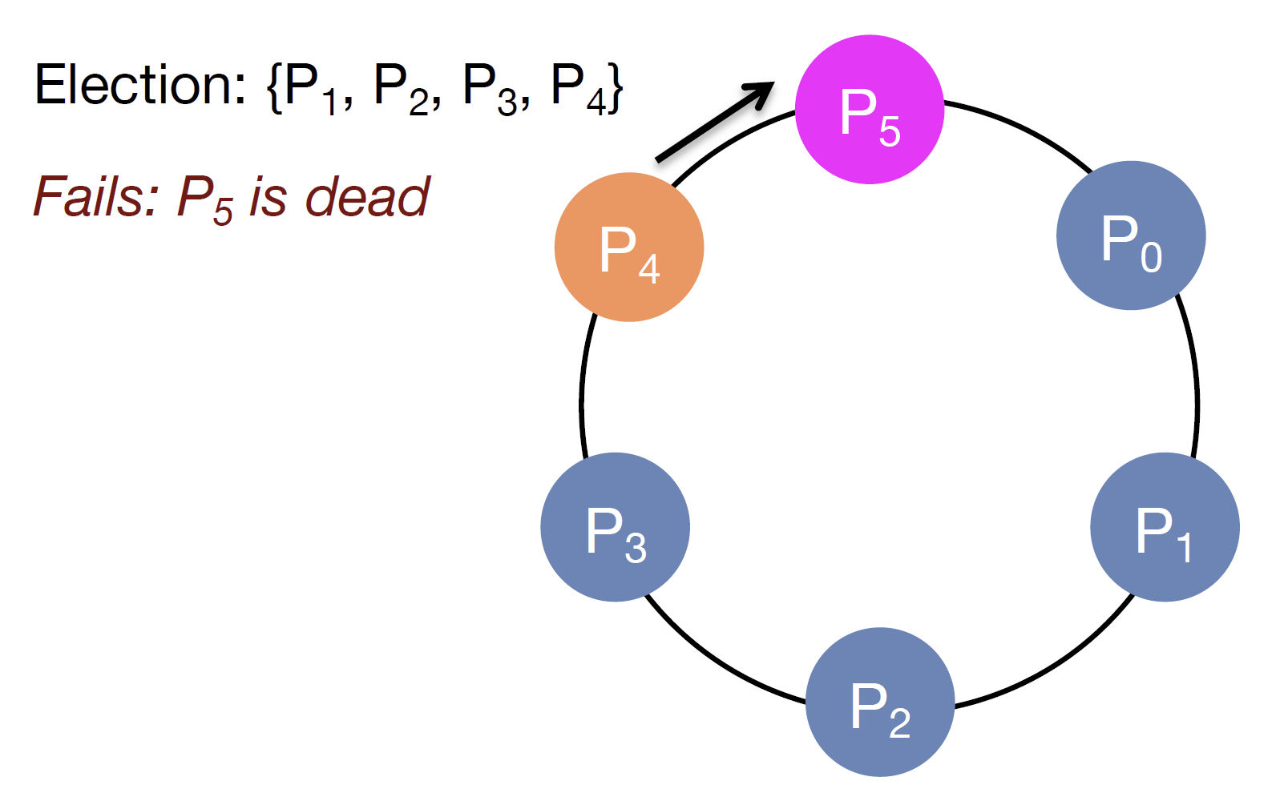
Ring Algorithm Example (IV)

Slide 51
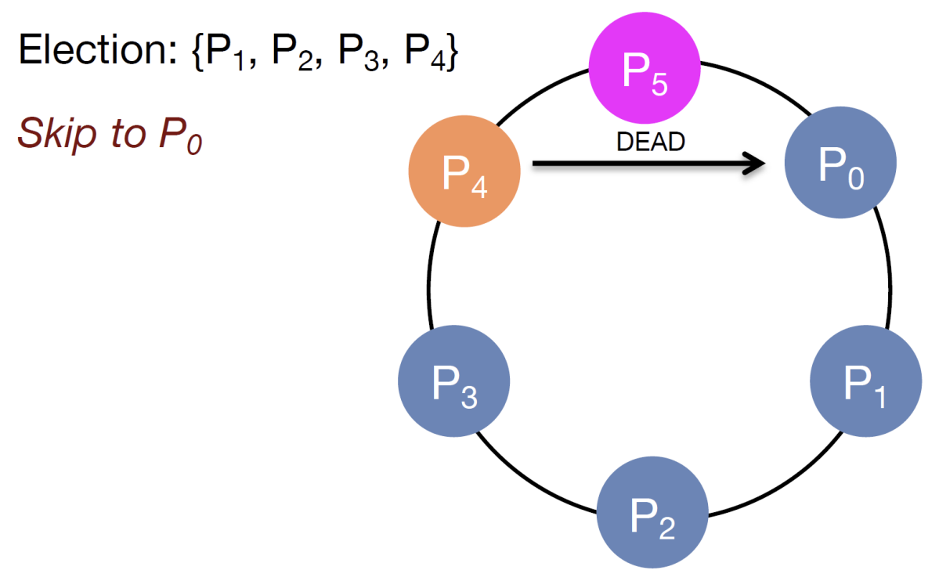
Ring Algorithm Example (V)

Slide 52
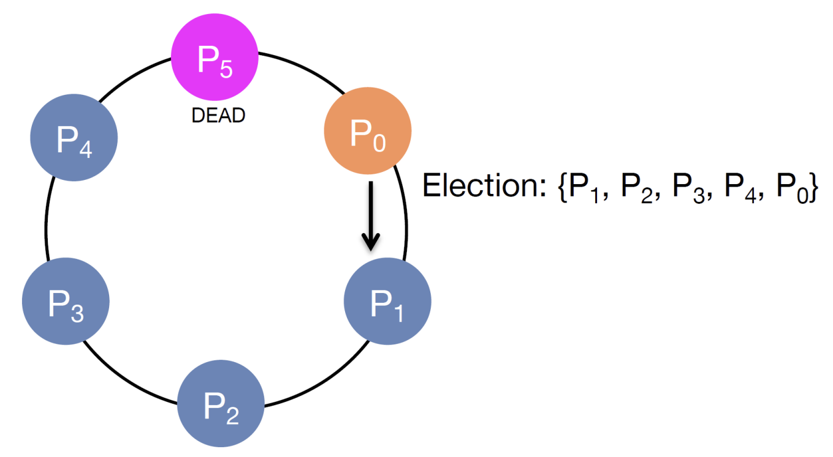
Ring Algorithm Example (VI)

Slide 53
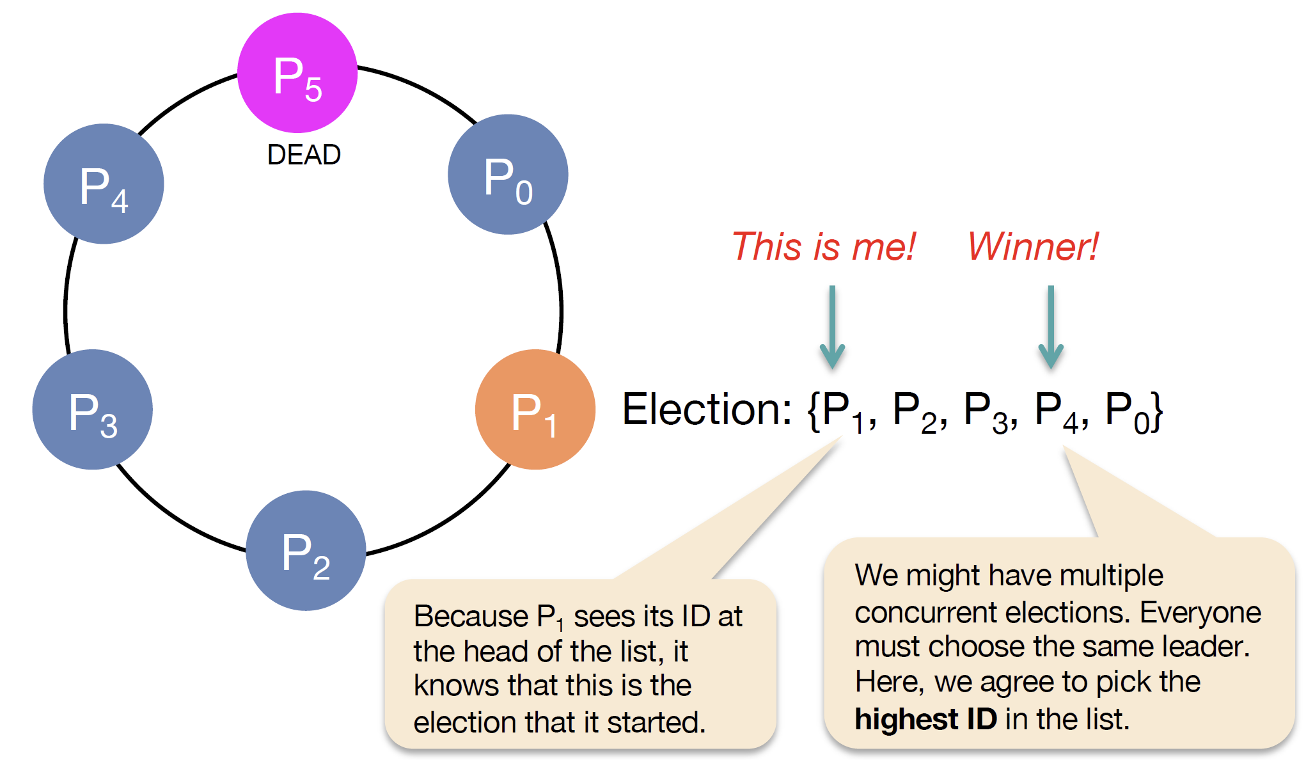
Ring Algorithm Example (VII)
P₁ receives the election message that it initiated.
P₁ now picks a leader (i.e., highest ID)

Slide 54
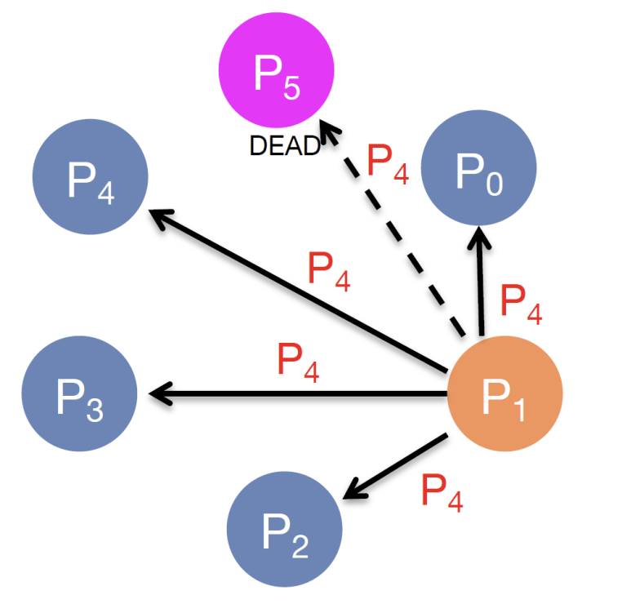
Ring Algorithm Example (VIII)
P₁ announces that P₄ is the new leader to the group.

Slide 55
Ring Algorithm (I)
We assume that the processes are physically or logically ordered, so that each process knows who its successor is.
When any process notices that the coordinator is not functioning, it builds an ELECTION message containing its own process number and sends the message to its successor.
If the successor is down, the sender skips over the successor and goes to the next member along the ring, or the one after that, until a running process is located.
At each step along the way, the sender adds its own process number to the list in the message effectively making itself a candidate to be elected as coordinator.

Slide 56
Ring Algorithm (II)
Eventually, the message gets back to the process that started it all.
That process recognizes this event when it receives an incoming message containing its own process number.
At that point, the message type is changed to COORDINATOR and circulated once again, this time to inform everyone else who the coordinator is (the list member with the highest number) and who the members of the new ring are.
When this message has circulated once, it is removed and everyone goes back to work.

Slide 57
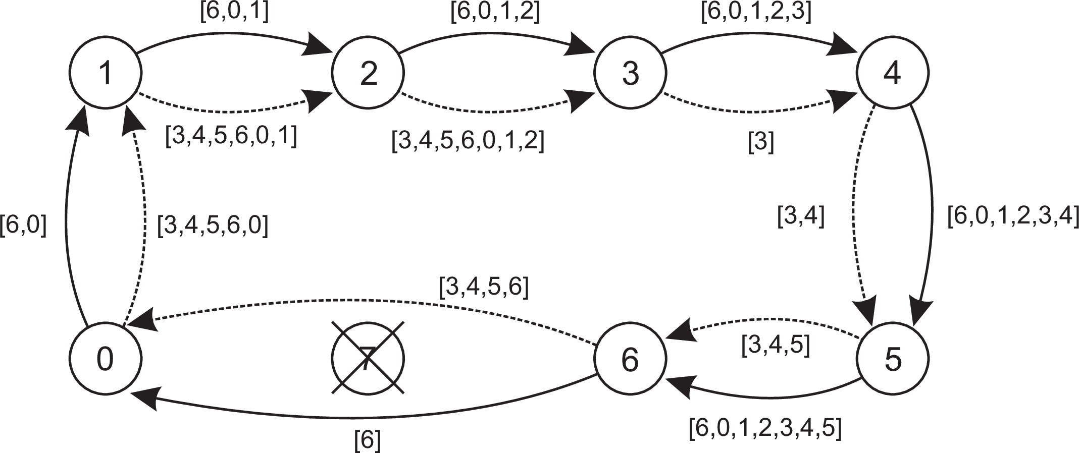
Ring Algorithm Example 2
The solid line shows the election messages initiated by P6
The dashed one, the messages by P3.

Slide 59
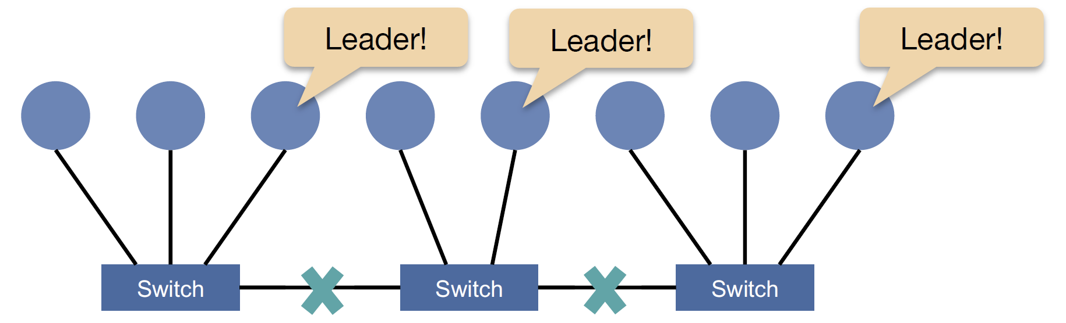
Network Partitions
Leads to multiple groups, each with a leader & diverging data among them.

Slide 60
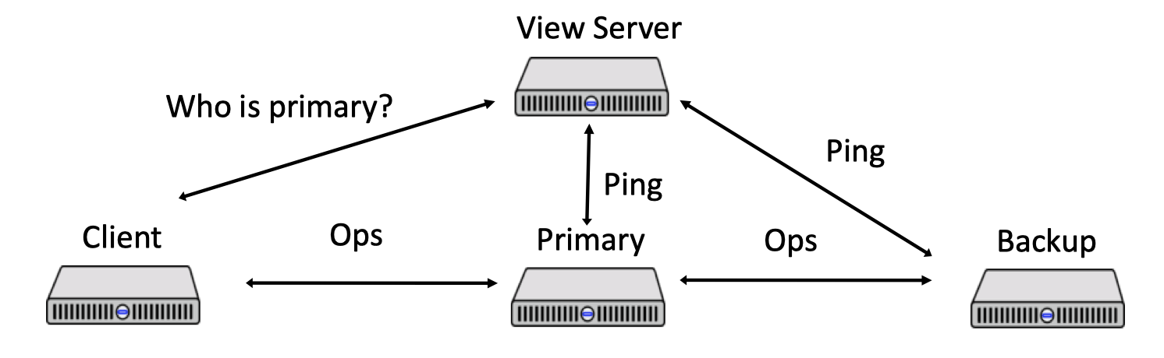
Test-and-Set Server (I)
Example: ZooKeeper.

Slide 61
Test-and-Set Server (II)
The test-and-set server maintains a flag that is initially set to false.
If the primary or backup thinks the other server is dead, and thus that it should take over by itself, it first sends a test-and-set operation to the server. The server executes roughly this code:
The primary (or backup)
only takes over ("goes live")
if test-and-set returns true.
test-and-set returns true
only to the first call.
The test-and-set server periodically
checks the primary status and resets the flag to false.
test-and-set() {
acquire_lock()
if flag == true:
release_lock()
return false
else:
flag = true
release_lock()
return true
}

Slide 62
Question 5: Retry?
Our assumptions so far
Fail-stop failure.
Reliable network (links).
We would like to relax our assumptions.
Fair-loss links. Messages may be lost.
What happens if message to the primary is lost?
What happens if message to a backup is lost?
Should we retry?
How many times?

Slide 63
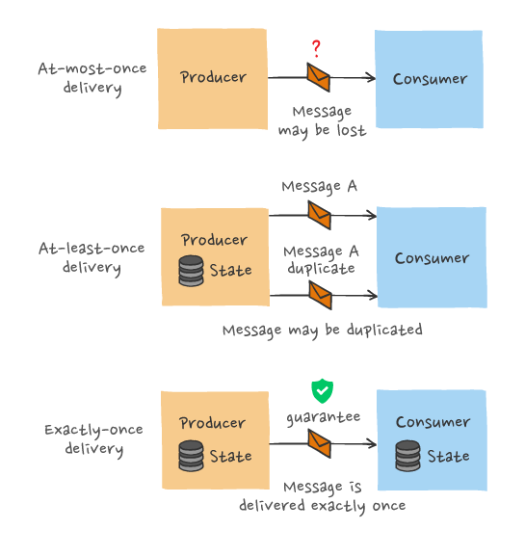
Retry Behaviors
At-most-once semantics:
Send request, don't retry, update may not happen
At-least-once semantics:
Retry sending request until acknowledged, may repeat update
Exactly-once semantics:
Retry, idempotency key/de-duplication

Slide 64
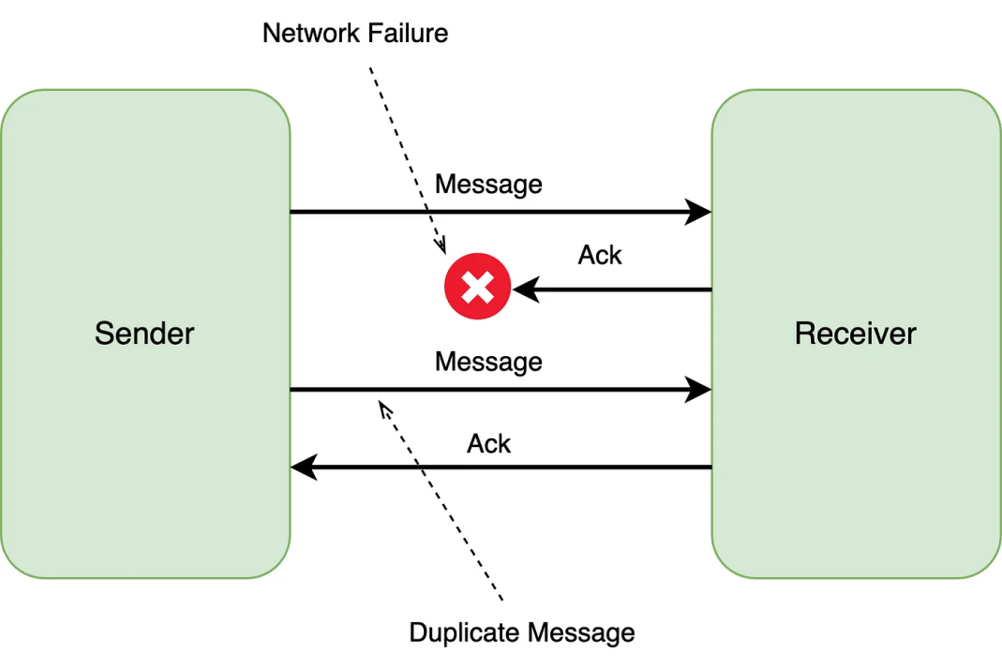
Question 6: Duplicated Messages?
Retrying leads to duplicated messages.

Slide 65
Idempotent Requests
A function f is idempotent if f(x) = f(f(x)).
Not idempotent: f(likeCount) = likeCount + 1
Idempotent: f(likeSet) = likeSet ∪ {userID}
Idempotent requests can be retried without the need for de-duplication.
Implementation: Request an idempotency key from the server and use it to make or retry the request.

Slide 66
Question 7: Membership Change?
How can primary-backup replication handle membership change?
Solution: Modify the configuration file and update the server array.

Slide 67
Question 8: How Do Clients Find Out the New Primary?
Solution 1: Use a designated IP.
Solution 2: Ask a backup.
Asking a backup results in one request being lost.
Solution 3: Backups as proxies.
Using backups as mediators reduces performance.

Slide 68
Number of Replicas to Tolerate Failures?
t fault tolerant: A system consisting of a set of distinct components is t fault tolerant if it satisfies its specification provided that no more than t of those components become faulty during some interval of interest.
Fail-stop failures.
2 replicas. t = 1.
3 replicas. t = 2.
5 replicas. t = 4.
t + 1 replicas. t = t.

Slide 69
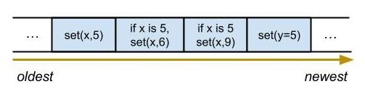
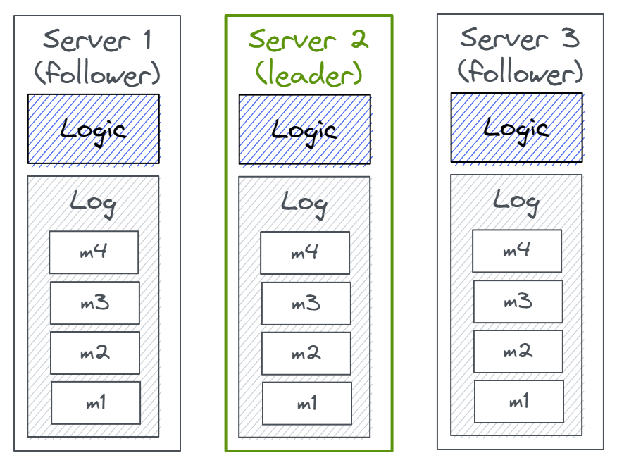
Question 9: Fail-recovery Failures?
Solution: Replicated log.

Slide 70
Question 10: Message Ordering?
As long as the two messages are sent over the same TCP connection, the order will be maintained.
However, if multiple connections are opened between the same pair of processes, maintaining the order of messages becomes challenging.
Fair-loss links. Messages may be lost. Retries may disrupt the order of updates from the primary to the backups.
Solution: Sequence numbers and buffering (temporarily storing messages).

Slide 71

Thank You & See You Again

